Slide 1

Mapping spatial data
David Jorgensen

Slide 2
Things to consider when mapping

Slide 3
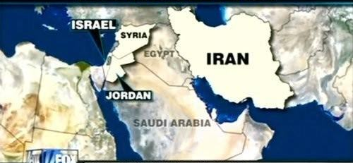


Factually correct
May seem obvious but can be easy to accidentally plot points in the wrong place or colour the wrong regions
Checking after plotting is important, especially when sharing information with others

Slide 4
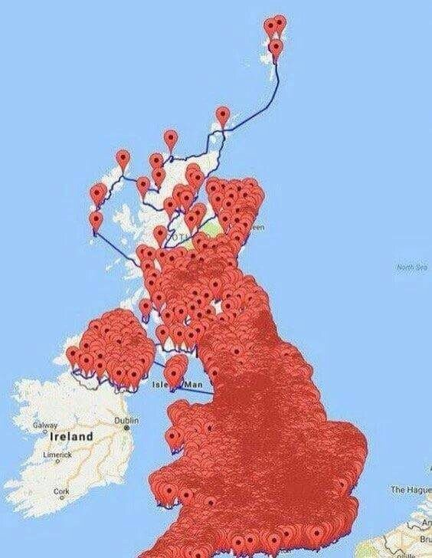
Interpretability
Some maps can overwhelm the reader, providing too much information or focussing on the wrong information
Getting someone else to proof read your map after plotting is a good way to see which areas stand out to them

Slide 5
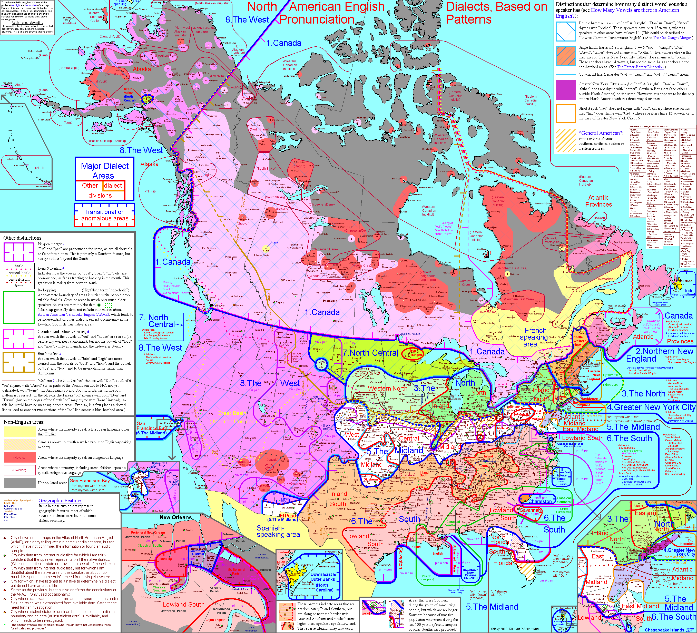
Interpretability

Slide 6
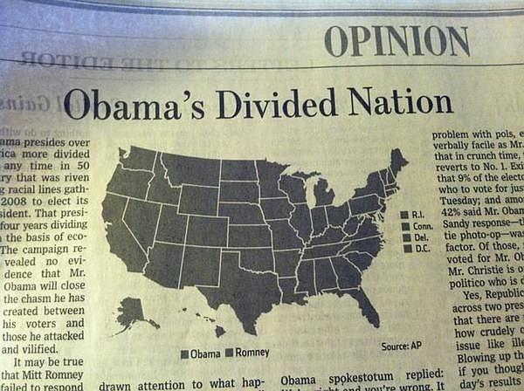
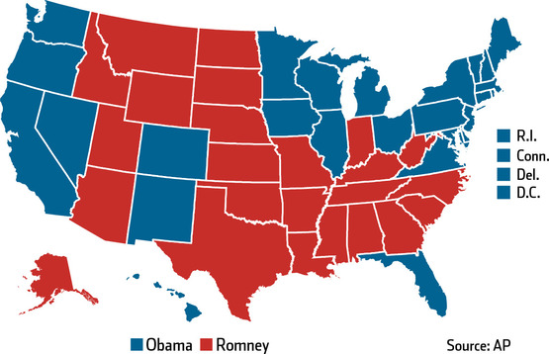
Colour
Colour is subjective, different people can see different colours differently and have opinions on what looks right.
Print and computer monitors can differ, colours can also be encoded differently online, considering final use is important.

Slide 7
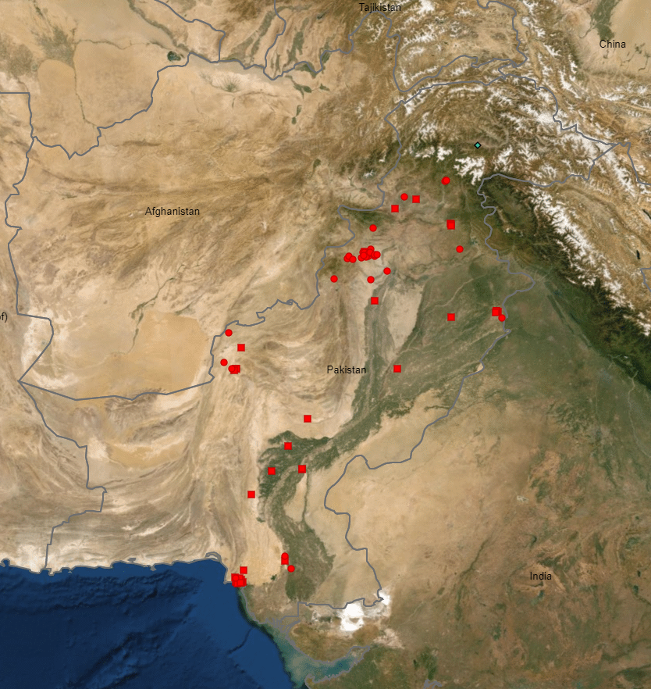
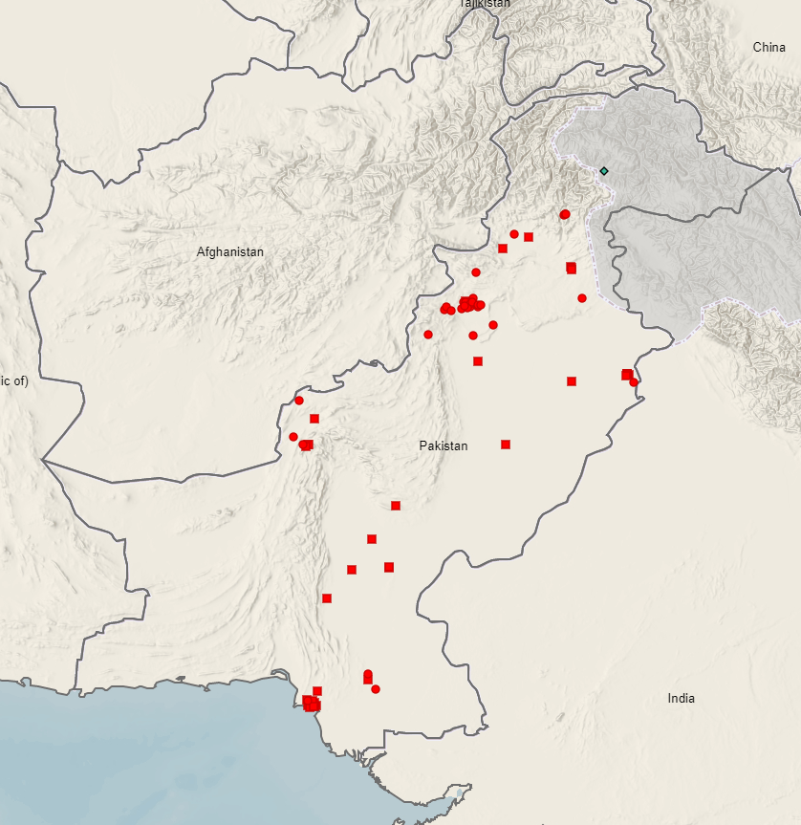
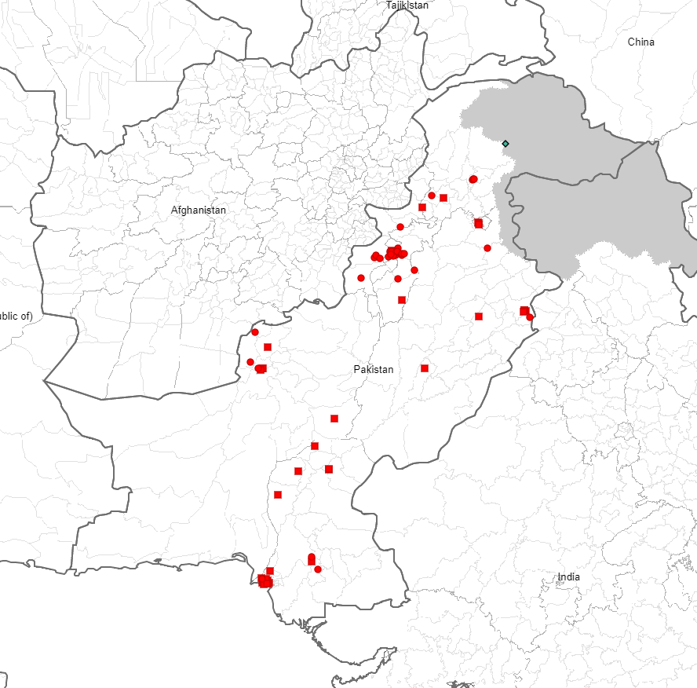
Background colours
Where information is not the primary interest of the map, keeping it plain or at higher transparency aids interpretation

Slide 8
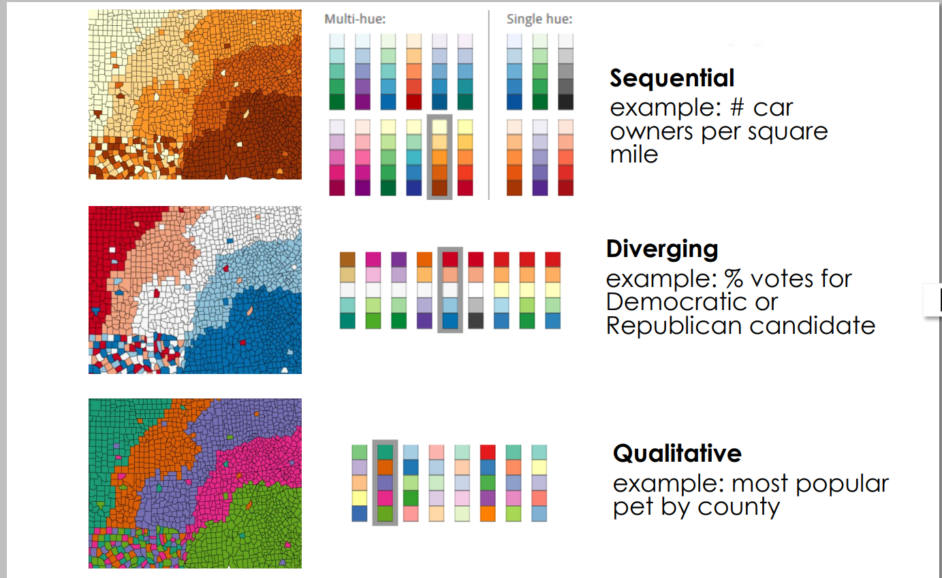
Different colour scales are appropriate for different data types

Slide 9
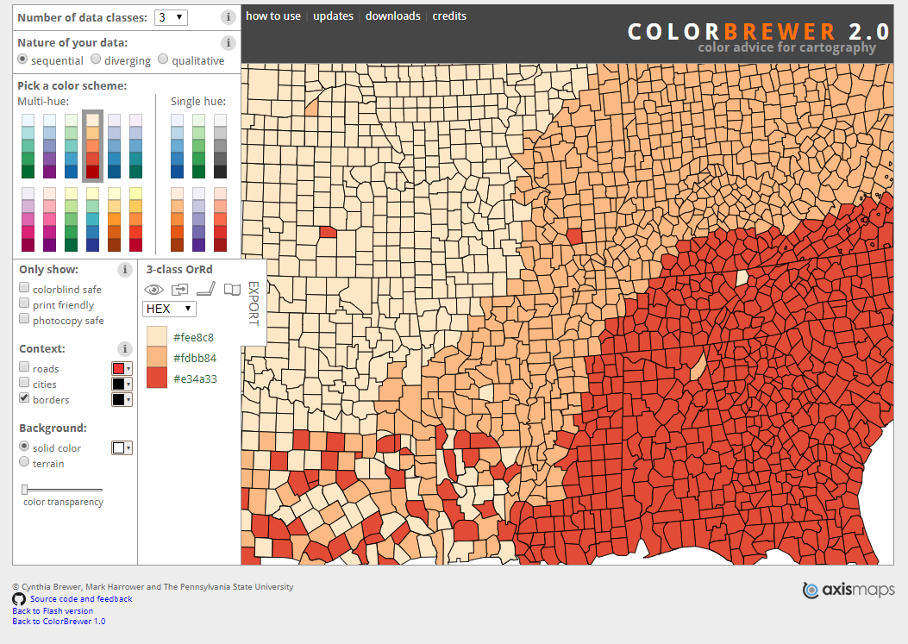
Color Brewer: http://colorbrewer2.org

Slide 10
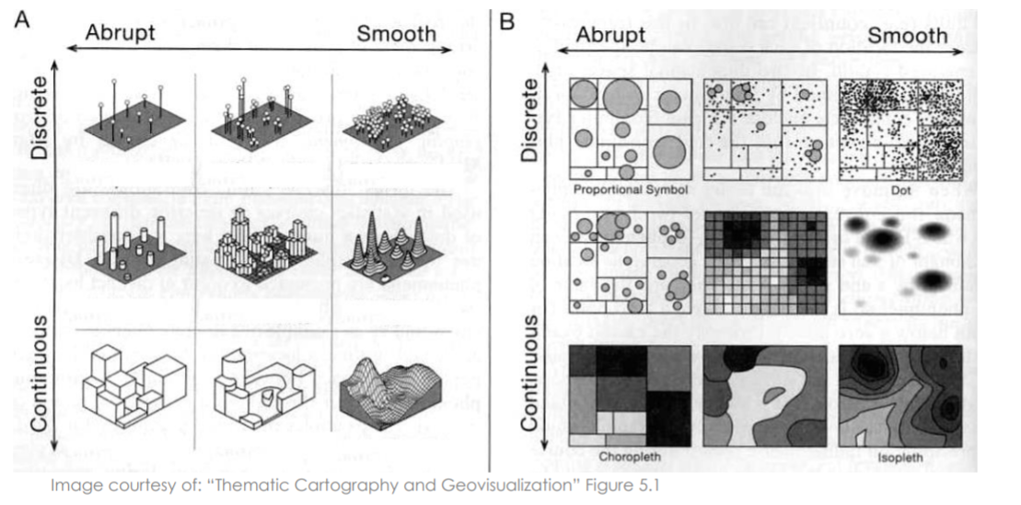
Data type

Slide 11
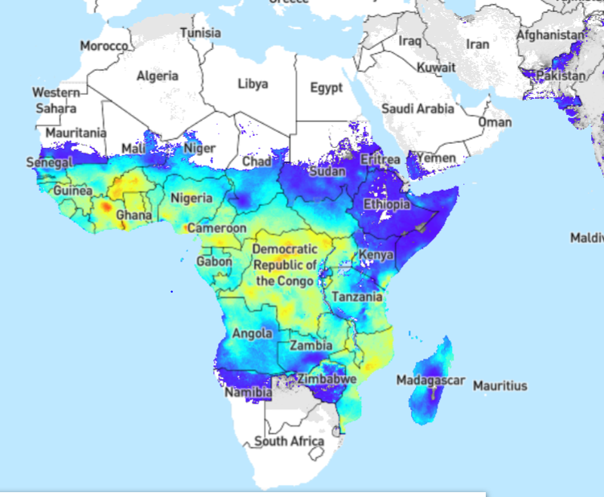
Data type

Slide 12
Isopleth maps
For continuous, smooth data
Colour by the level of a variable – these are Malaria risk maps
Often used for things such as rainfall or temperature which change over space smoothly.
Easy to interpret
map.ox.ac.uk

Slide 13
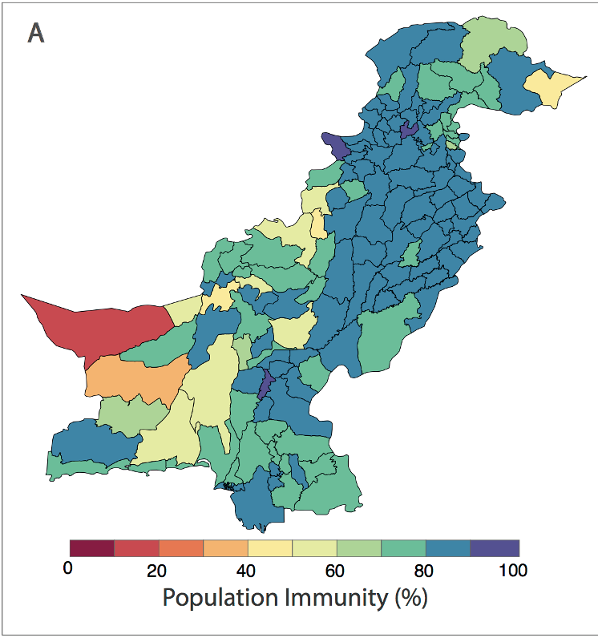
Data type

Slide 14
Choropleth maps
Continuous data which is abrupt, usually at the borders of defined regions.
Choropleth maps show more clearly which administrative units are most important
Lose detail at the sub-regional level as it assumes data is uniform across the area.
Can make larger places seem important even if they have very small population
Natalia Molodecky

Slide 15
Data type

Slide 16
Dot maps
Good for discrete data such as occurrence of an event.
Usually used where individual events are recorded rather than for aggregated counts (we will break this rule in the R session!)
Not very informative for uniform data.
Easy to understand and show density well.
GPEI

Slide 17
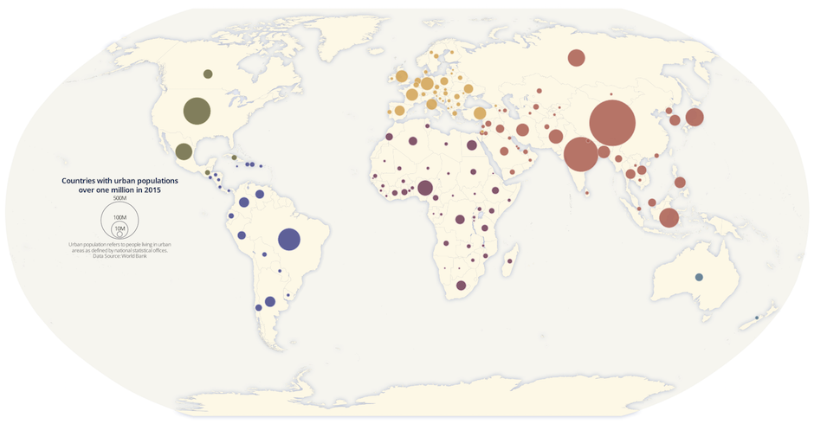
Data type
Notes:
Urban population

Slide 18
Proportional maps
Good for discrete data such as counts within specific areas.
Symbol size increases with value
Gives a good idea of relative size quickly
Not often seen so people are bad at interpreting them. Not helped by size of circles being difficult to estimate
World urban population density

Slide 19
Scale
The extent of a map should only cover what is relevant to the data, insets can be used to show the wider context

Slide 20
Can your map stand alone?
The best maps are self explanatory, with a legend for anything which may be unclear.
Labels can aid interpretation

Slide 21
Visualising spatial data in R

